Slide 1
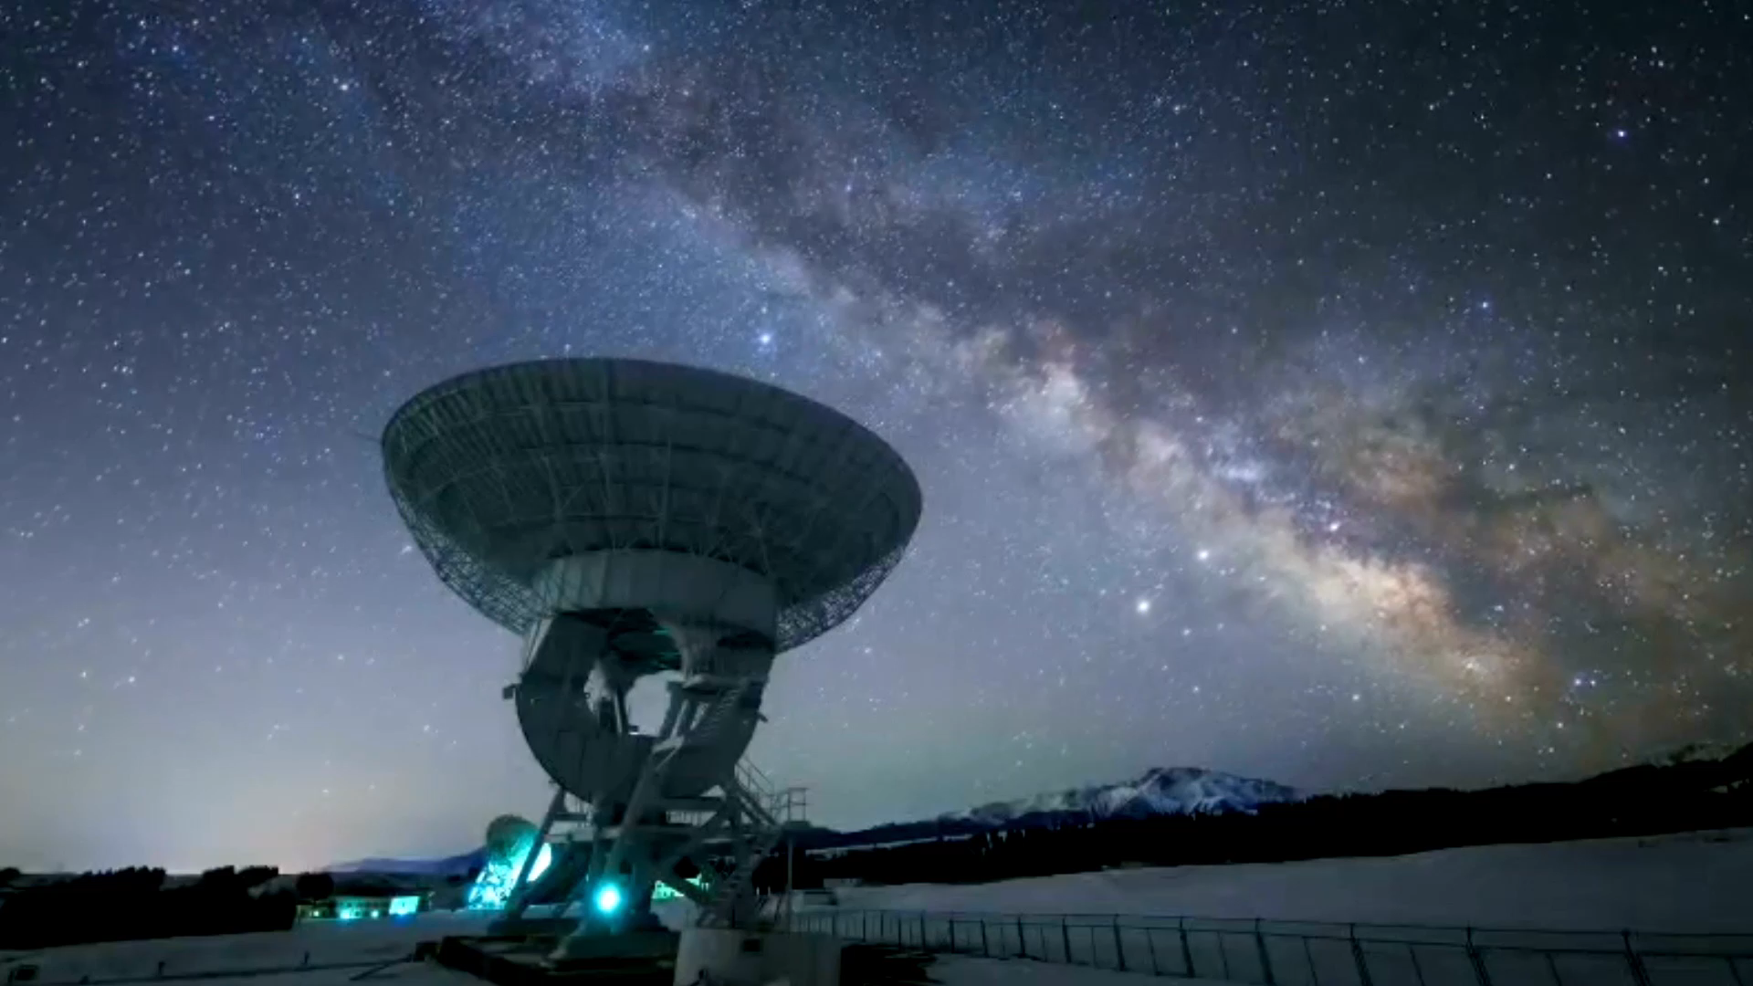
Weather Station Workshop
By
Diego Santiago Uriarte
Carlos Acevedo Morales

Slide 2
Introduction
In this workshop we will work on the development of a personal weather station using an engineering approach
The engineering approach helps us tackle the development of a project using structured steps

Slide 3
Agenda
Engineering Approach
Define the Problem
Research
Brainstorm
Picking a solution
Developing Prototype
Testing
Communicating Results

Slide 4

Before we Begin
Download RealVNC Viewer from the app store!

Slide 5
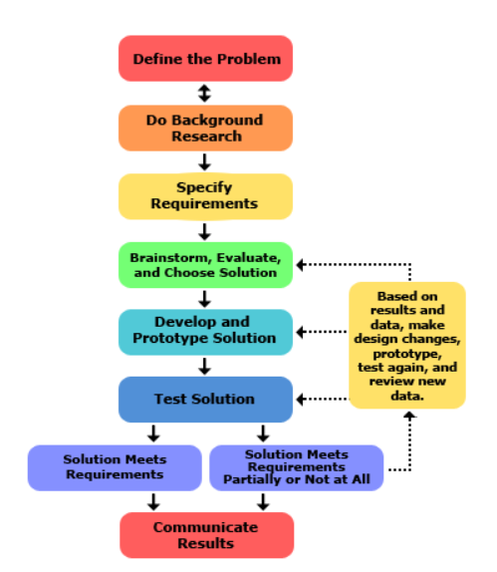
Engineering Approach

Slide 6
Define the Problem
What is the problem?
Who has this problem?
Why is this problem important?

Slide 7

Mind Map Exercise
Using your tablet, open up a sketching application such as notes and create a mind map answering the questions

Slide 8

Define the Problem
Problem Statement: Find a way to measure weather conditions / air quality conditions locally without relying on internet or remote sensors.

Slide 9
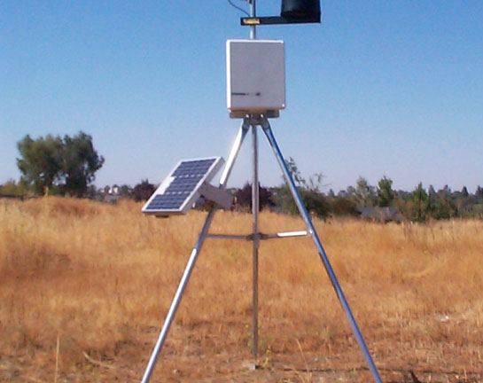
Research
^{What is a weather station?}
What are the components for a weather station?
What do we need to make our weather station?

Slide 10
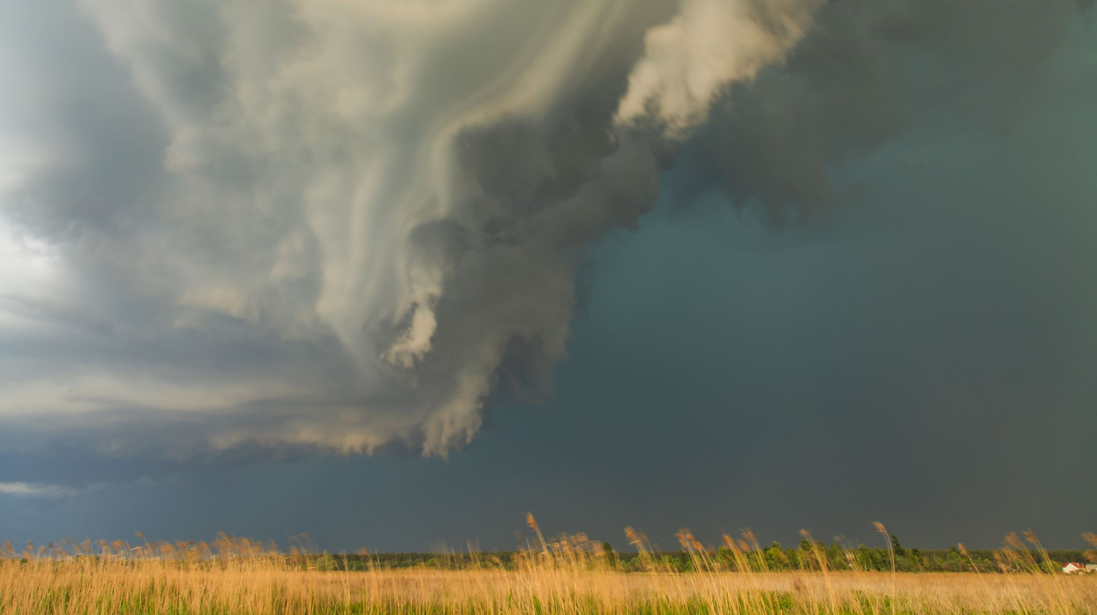
What is a Weather Station
An observation post where weather conditions and meteorological data are observed and recorded.
Most weather stations will measure temperature, humidity, barometric pressure, wind speed and direction, and rainfall.

Slide 11
What are the components for a weather station ?
Thermometer: measures temperature
Hygrometer: measures humidity levels
Anemometer: measures wind speed
Wind vane: measures wind direction
Barometer: measures atmospheric pressure
Rain gauge: measures how much rain has fallen
Air quality sensor: measures air quality

Slide 12
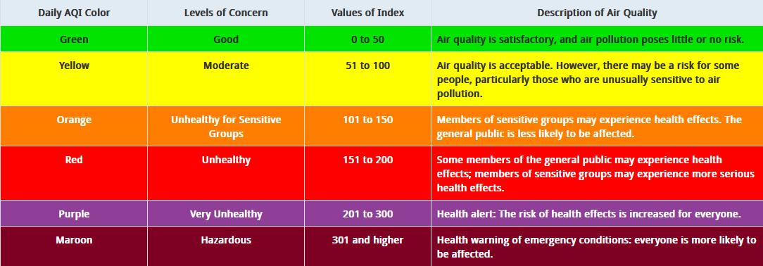
Air Quality Index
Think of the AQI as a yardstick that runs from 0 to 500. The higher the AQI value, the greater the level of air pollution and the greater the health concern. For example, an AQI value of 50 or below represents good air quality, while an AQI value over 300 represents hazardous air quality.

Slide 13

The importance of Air Quality
Exposure to high levels of air pollution can cause a variety of adverse health outcomes. It increases the risk of respiratory infections, heart disease and lung cancer. Both short and long-term exposure to air pollutants have been associated with health impacts.
Air pollution is also detrimental for our environment, causing adverse effects for wildlife, acid rain, eutrophication, crop and forest damage, and continuing contribution to global climate change
The video illustrates smoke covering new York due to forest fires in Canada. The air quality index in new York has reached close to 200

Slide 14

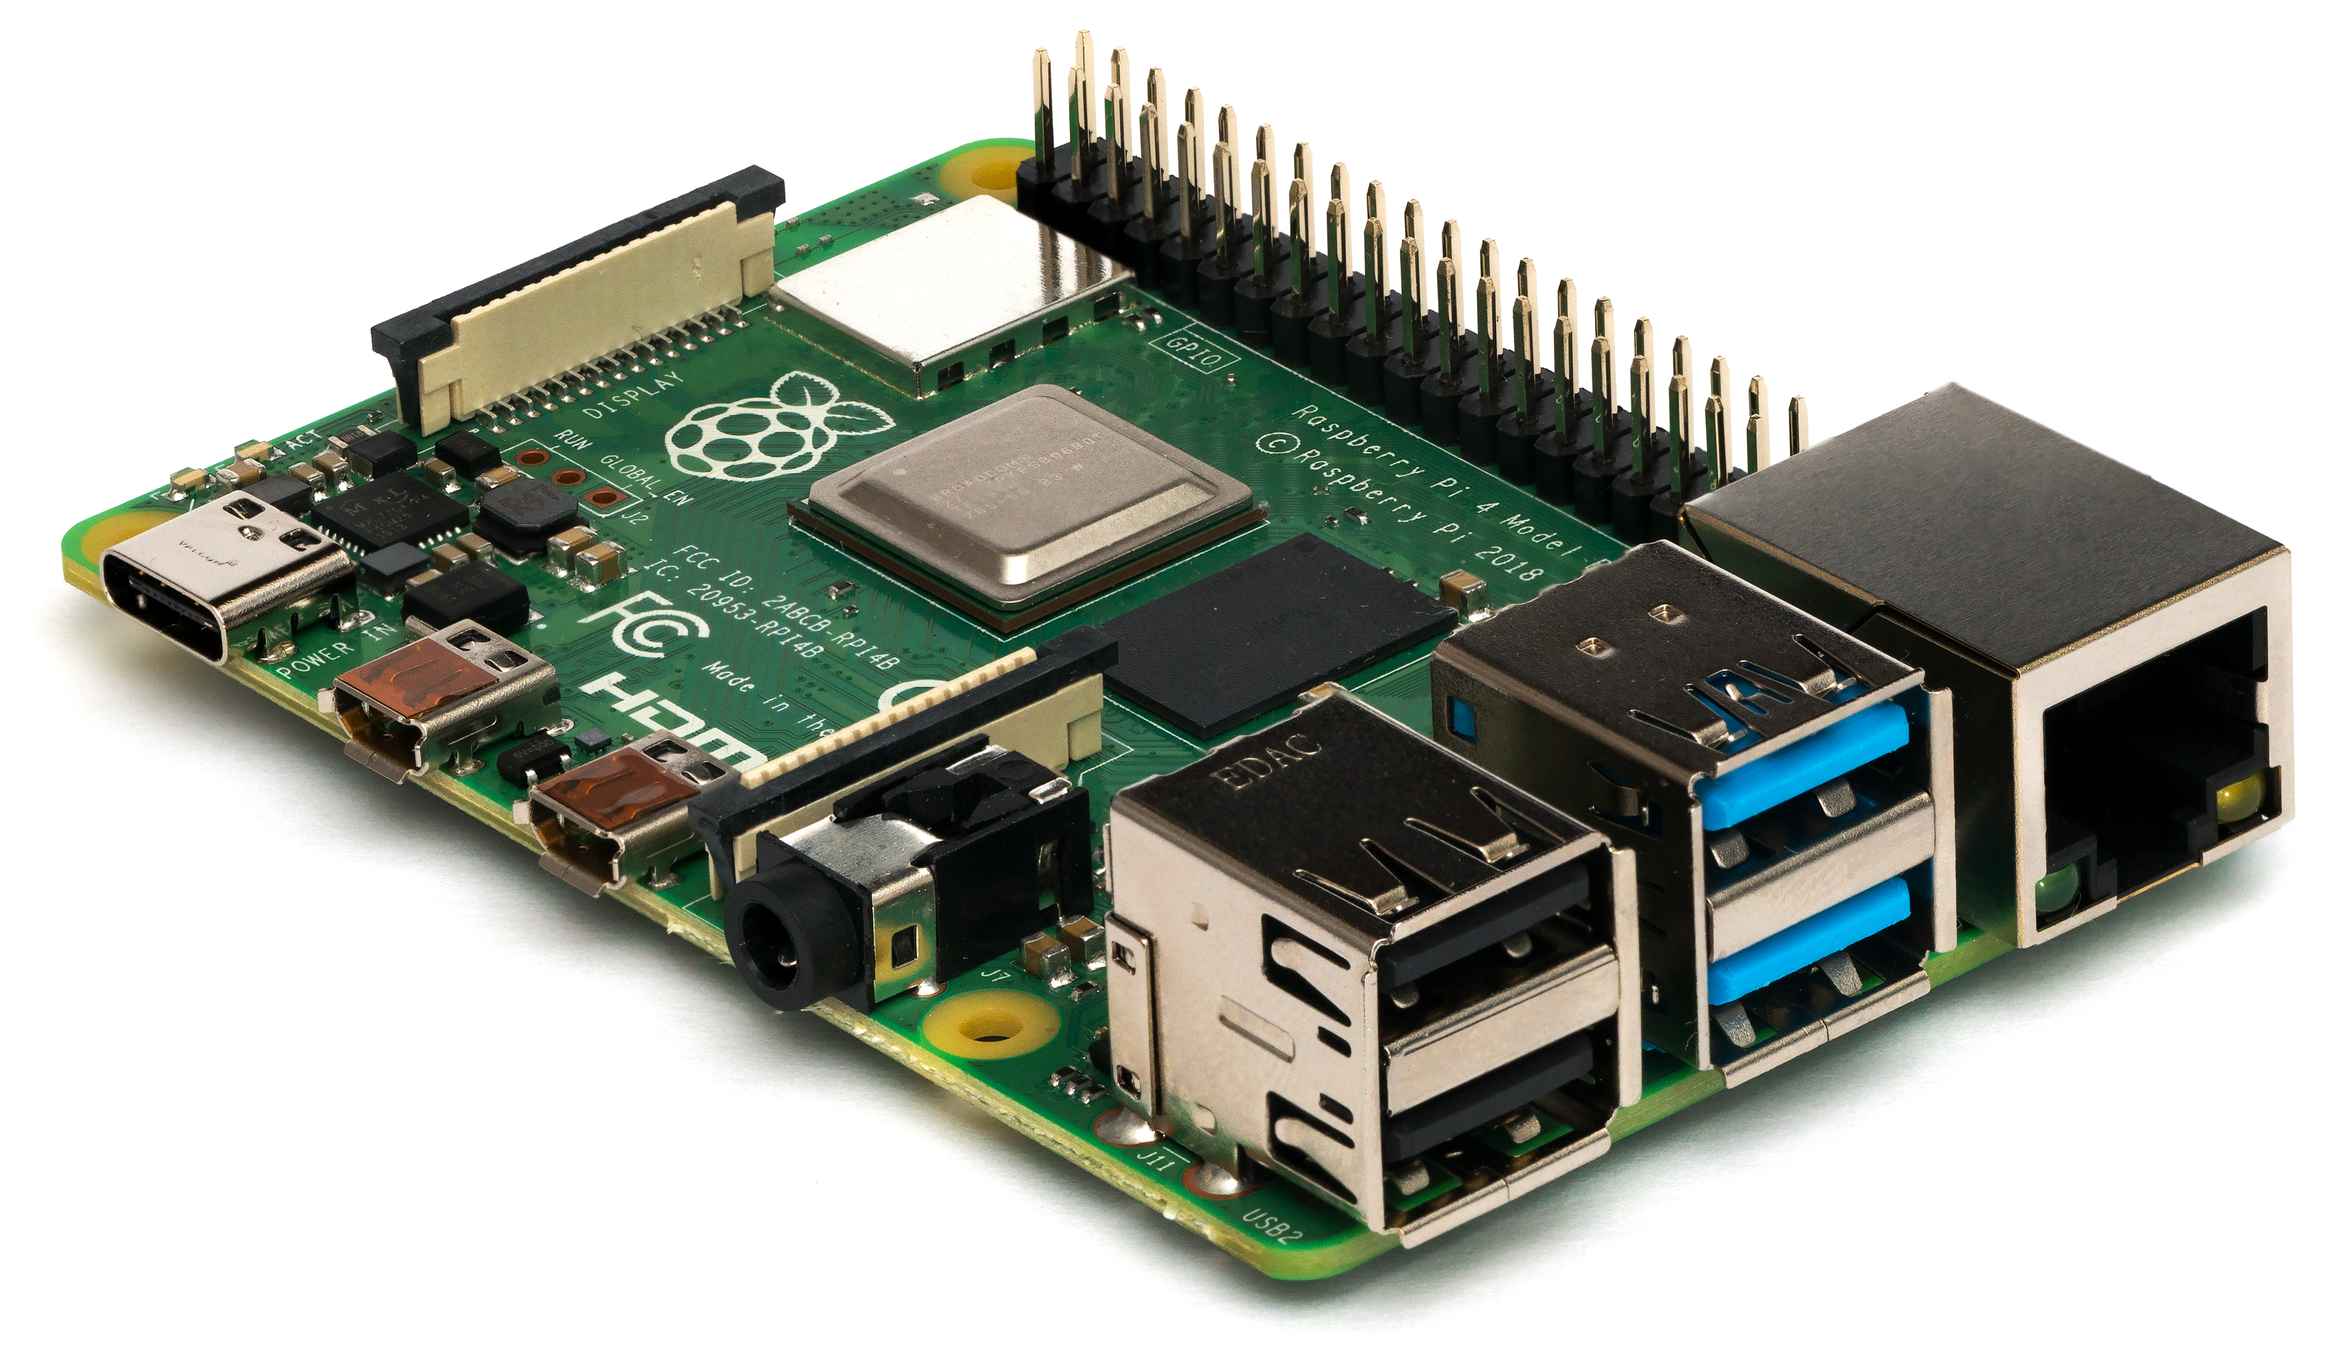
Computer Ideas
Arduino
Raspberry pi
Personal computer
Texas instruments launchpad
Embedded circuits

Slide 15

Brainstorm
Based on the ideas presented and research how can we integrate our project?
Potential solutions:
Read raw data from sensors and manually analyze them
Take raw data and use computer application to analyze it
Use an Arduino to connect sensors and analyze data
Use a Raspberry Pi to connect sensors and analyze data
Use an embedded system to both read sensor data and analyze data

Slide 16

5-minute break

Slide 17
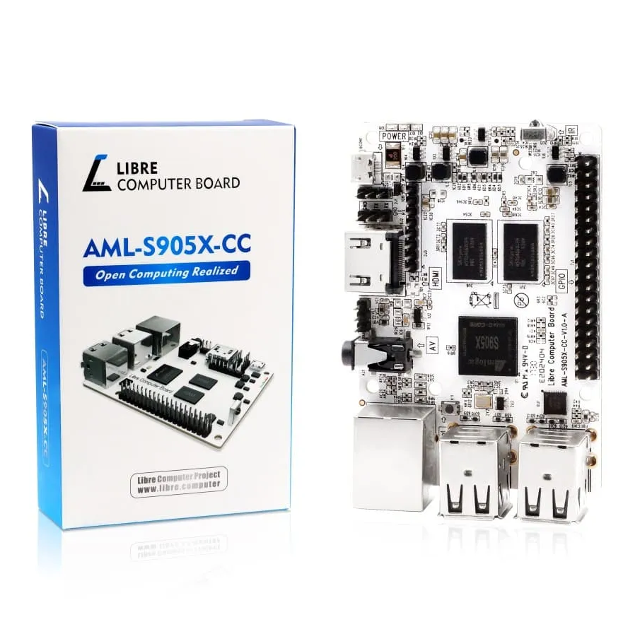
Best Solutions
Libre Computer AML-S905X-CC (Le Potato):
Lower Cost than Raspberry Pi
Easily available (no product shortage or scalping)
Raspbian OS available.
Same capabilities albeit weaker than Raspberry Pi
Wi-Fi Module is plug and play.

Slide 18
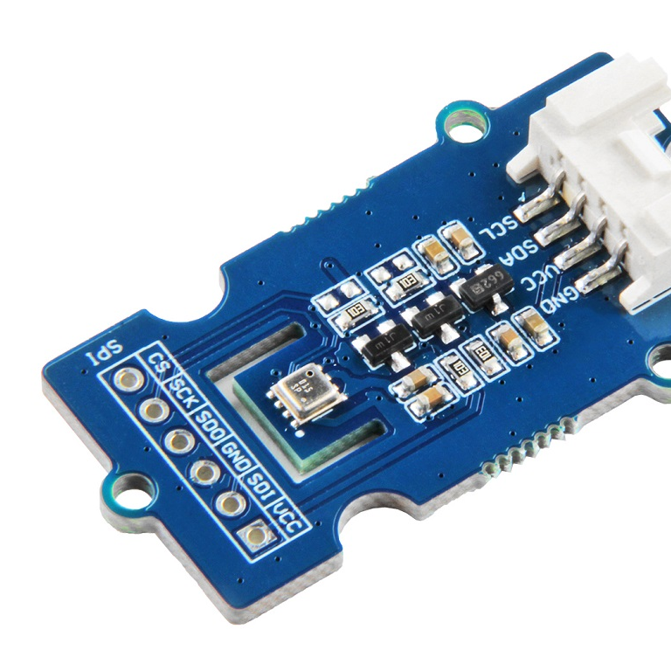
Best Solutions
Grove All in One Sensor:
Captures Temperature, Humidity, Pressure and Gas Resistance
Works via I2C, quite universal connection type.
Has Python Libraries available.

Slide 19

Best Solutions
Python programming language:
Beginner friendly programming language
Widely used
Has libraries compatible with Grove Sensor
Works easily with Raspbian OS

Slide 20

Developing a Prototype

Slide 21
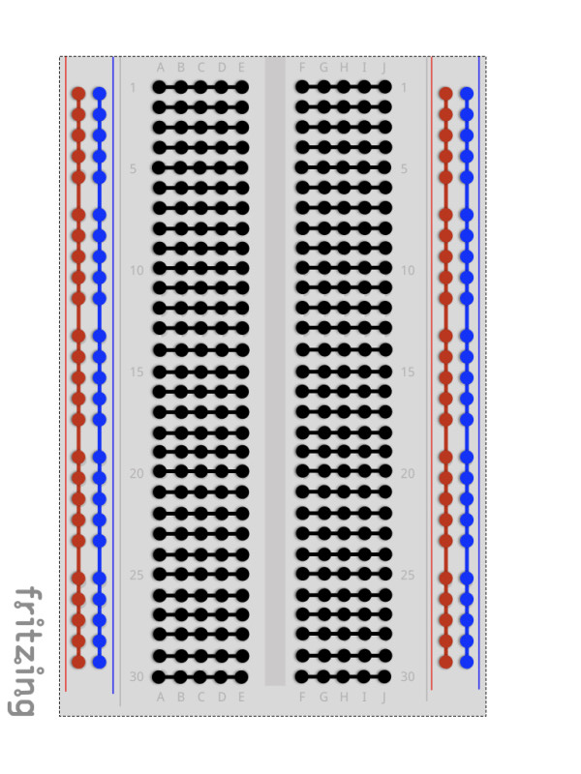
How a Breadboard works
The breadboard connections are as shown in the diagram:
If you wanted 2 components to be connected, they would be on the same row.

Slide 22
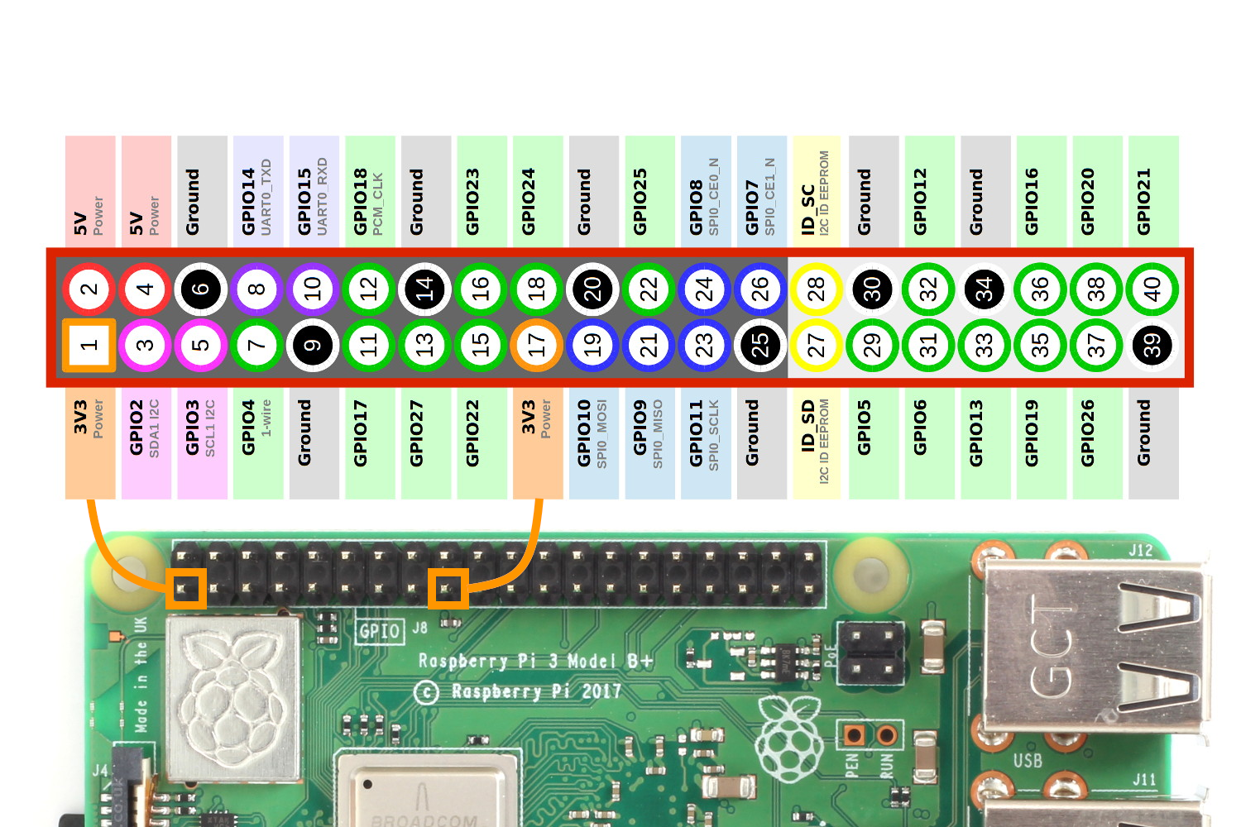
Le Potato GPIO

Slide 23
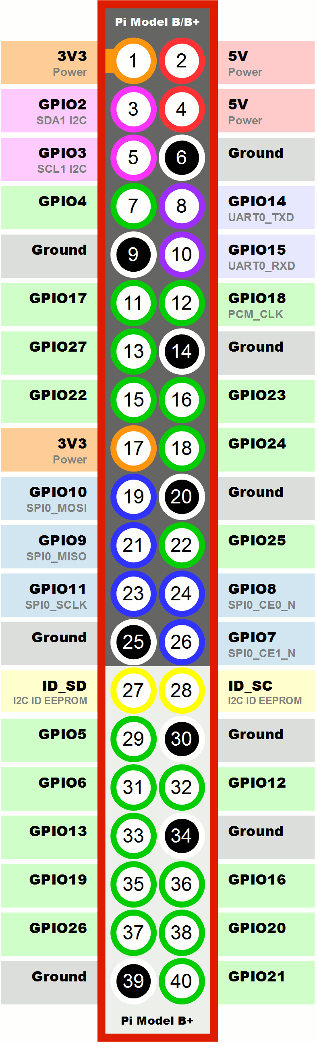
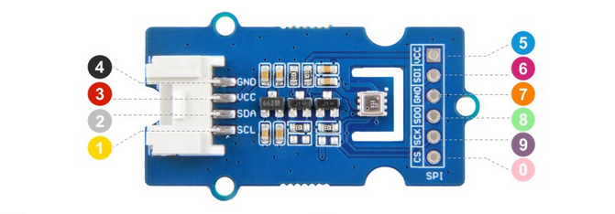
Computer to sensor connections:
Sensor 1 -> GPIO 3 (SCL)
Sensor 2 -> GPIO 2 (SDA)
Sensor 3 -> 5V in Le Potato
Sensor 4 -> Ground in Le Potato

Slide 24
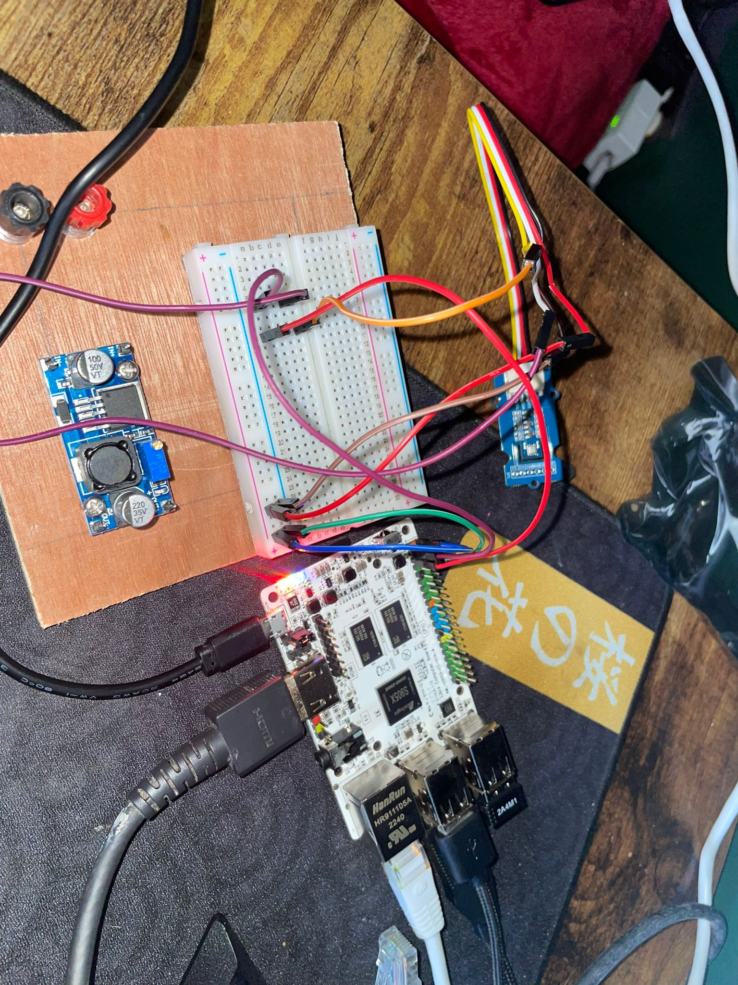
Connect Sensor and computer
Follow the instructions to connect each cable in its proper position, this will allow the Potato to communicate with the sensor via the I2C protocol. Please ask for help if you are unsure!

Slide 25
Connecting to computer from Tablet using VNC Viewer
Ensure your VNC Viewer Connection:
1. You were given a number at the beginning of the workshop, use this number to connect to your Le Potato. Press the + symbol to add a connection, in the address box, you will type the following:
NASANUM.local:1 Replacing every instance of NUM with the number you were given.
Example for user1: NASA1.local:1
Example for user10:
NASA10.local:1

Slide 26
Connecting to computer from Tablet using VNC Viewer
You will probably be given a scary red warning, but this does not actually mean anything for now, simply click proceed and enter the password which is the same for everyone: nasanasa

Slide 27
Connection Established!
Now you should be looking at a desktop. This desktop is your Le Potato!
Now we can become familiar with the Potato to successfully finish this project.

Slide 28
We will use the Linux terminal to perform all the operations necessary for the project.
Even though it may look intimidating, it is really not too complicated!

Slide 29
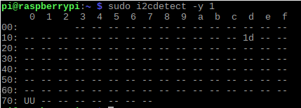

Testing
echo hello world!
cd
ls
sudo i2cdetect –y 1

Slide 30
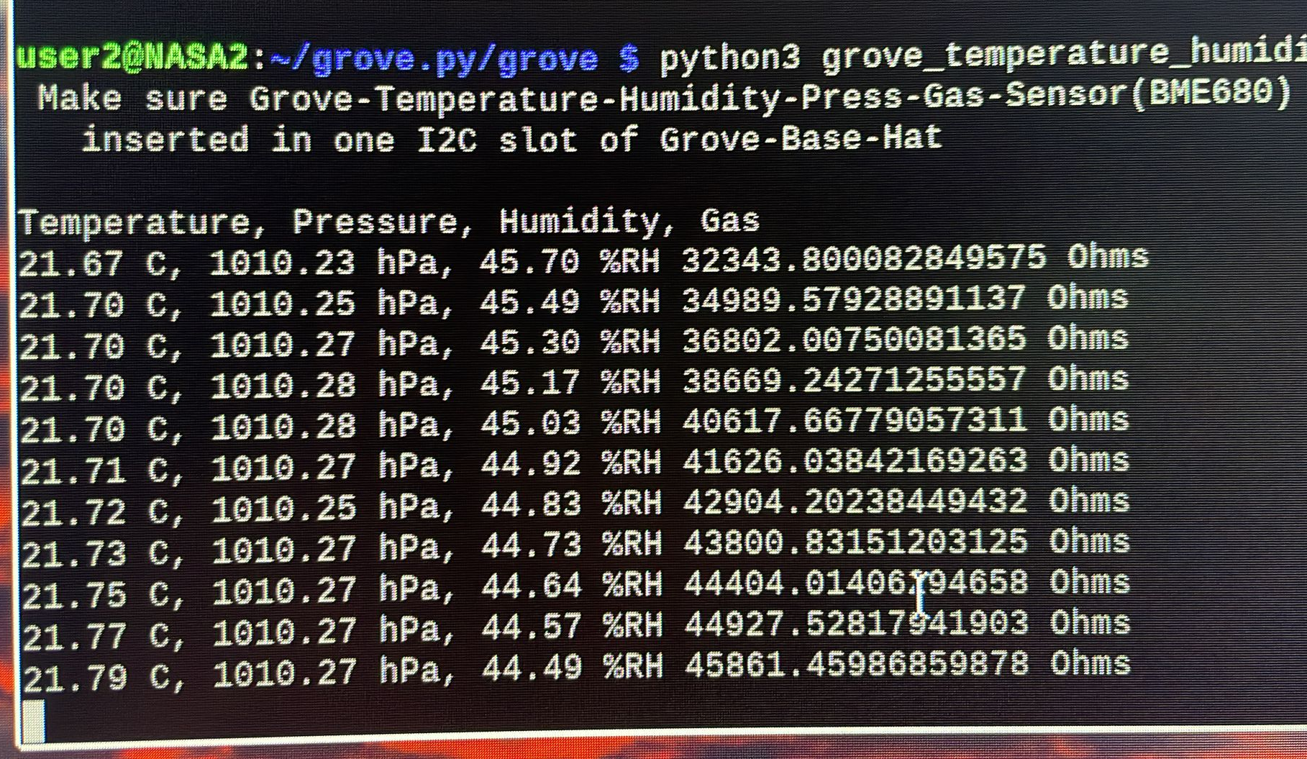
Testing
Once we are all connected, we can try running the following commands:
cd ~
cd NASA-SUMMER/code
sudo chmod +x setup.sh
./setup.sh
sudo i2cdetect –y 1
python3 weatherRaw.py
Now, in the terminal, you should see different data be shown by the sensor!

Slide 31
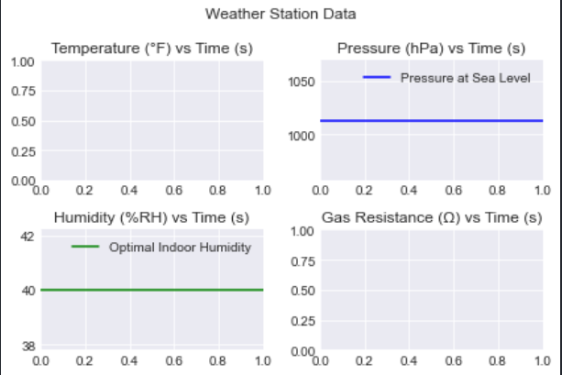
Testing
What are the limitations of our project?
How can we improve our project?
Let’s try running a more sophisticated program to visualize the data
python3 weatherGraphs.py

Slide 32

Communicate Results
After analyzing results from the testing phase, we communicate this analysis
Usually, we want to make a detailed document regarding the project

Slide 33

References
https://wiki.seeedstudio.com/Grove-Temperature_Humidity_Pressure_Gas_Sensor_BME680/
https://climatekids.nasa.gov/menu/weather-and-climate/
https://github.com/Seeed-Studio/grove.py
https://learn.sparkfun.com/tutorials/graph-sensor-data-with-python-and-matplotlib/update-a-graph-in-real-time
https://jayconsystems.com/blog/understanding-a-gas-sensor
https://www.weatherstationadvisor.com/what-is-a-weather-station/
https://www.airnow.gov/aqi/aqi-basics/

